Slide 1
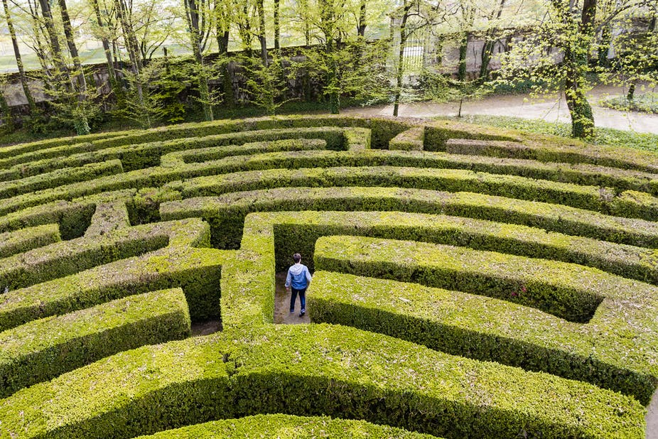
Project the maze
Programmer name: Doron Shmueli
ID: 213204035
Teacher: Anatoly Pyemer
Grade: 10(3)
School: Neomi Shemer

Slide 2
Table of contents
Intro ……………………………......Page 3
Main Idea ……………………….… Page 4
Manual guide ………………….… Page 5
How to play …………………………… Page 6
Game version …………………..… Page 7
Flow chart ……………………….… Page 8 -12
Proc explanation ………………… Page 13
The code ………………………….… Page 14 - 22
Example’s of running …………. Page 23 - 24
Personnel summery ………….. Page 25
Thanks ………………………….… Page26

Slide 3
INTRO
Project name: The Maze
File name: Project.exe
Workspace: Turbo Assembler
Develop space: Notepad++
Running space: DOSBox
Other files:
BitMap.inc
Player.inc

Slide 4
Main idea
As a child, I always used to play and solve maze’s.
Nowadays, unfortunately, all games are violent games, so my little brother has nothing to play online, I saw this project as an opportunity to make him a game that he can both develop his mind and enjoy it.
In the maze the player needs to finish the route without touch any of the walls.
If the player touch one of the walls he must to start over all the maze from the beginning.

Slide 5
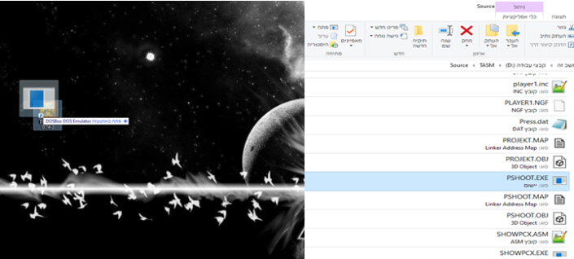
Manual guide
First, you need to download DOSBox x86
You need to drug the exe file into the DOSBox icon on your desktop.

Slide 6
How to play
When you will open the game as I showed in the last page, there will be a menu for you to choose what would you like to do:
If you would press 1, you will start to play and the maze’ and to try finish it.
If you would press 2, you will see the rules of the game and how to play in it.
If you would press 3, you will see some details about the creator and the school he learned in.
If you would press 4, it will take you back to the DOSBox app.
If you would press the Esc button in every part of the game it will take you back to the menu.
HOW TO WIN THE GAME?
If you want to win in the game, you will need to use the arrows key’s in your keyboard.
To reach for the end screen of the game you will need to get your player (the red dot) to the end of the maze (the pink portal).

Slide 7
GAME Version
At the next version will be:
A new maze, I would like to add more levels and to make another maze for the users.
The character in the game will change from the red dot to a human who tries to finish the maze.
I will add a timer for the user to finish the maze, at the second maze the time will be much shorter then the first one.
I will add a live counter for the player’ and in every run you will have 3 lives to try and finish the maze.

Slide 8
FLOW CHART
Order
If
Call proc
Start \ End
Reference to a different place in the flowchart
Loop for

Slide 9
Main menu of the game
start
Draw MenuMain
Al=clicked button
Al==31h
T
F
Al==32h
T
F
Al==33h
T
F
Al==34h
Game
T
F
end
RulesHow
AboutMe

Slide 10
Game proc
start
1
Xplayer = 3
Yplayer = 3
CHANGE TO GRAPHIC MODE
DRAW MAP
2
Xplayer = 3 + Xplayer
Yplayer = 3 + Yplayer
ReadPixle
Xplayer = Xplayer - 3
Yplayer = Yplayer -3
Al==1
T
F
T
Al==5
F
1
ReadPixle
3
T
F
Al==1
1
4

Slide 11
4
DRAW MAP
5
Ah = clicked button scan code
Ah
== up_key
T
F
T
Ah
== down_key
6
F
7
Ah
== right_key
T
F
8
Ah
== left_key
T
F
9
Ah
==
1
T
F
10
1

Slide 12
Move player up
6
Yplayer --
Move player down
7
2
Yplayer ++
2
Move player right
8
Xplayer ++
Move player left
9
2
Xplayer --
Show win screen
3
2
Show_win
Return to txt mode
10
Change to txt mode
end

Slide 13
PROC EXPLANATION
Proc RulesHow
Showing to the user the rules and how to play screen.
input: None.
Output: Shows the Rules and How to play screen
Proc AboutMe
Shows to the user the about the creator screen.
Input: None.
Output: Shows the About the creator screen.
Proc Game
Show and run the game for the user.
Input: Xplayer , Yplayer , Wplayer , Hplayer , player , Xmap ,Ymap, Wmap , Hmap , Map.
Output: Playable game.
Proc ReadPixle
Checks the pixel's color by his x,y
Input: Xplayer , Yplayer
Output: al (The hit color)
Proc DrawMovingImage
Drawing the player and the map in the game and showing it to the user.
Input: ImageW , ImageMaskOffset , ImageX , ImageY,
ImageH.
Output: Draw the player on the user screen.
Proc PutPixle
put colors for each pixel in the screen.
Input: ImageX , ImageY.
Output: Draw’s the pixel in the current x,y
(ImageX , ImageY).
Proc Show_Win
Showing to the user the win screen of the game.
Input: WinScreen (offset)
Output: Shows the win screen

Slide 14
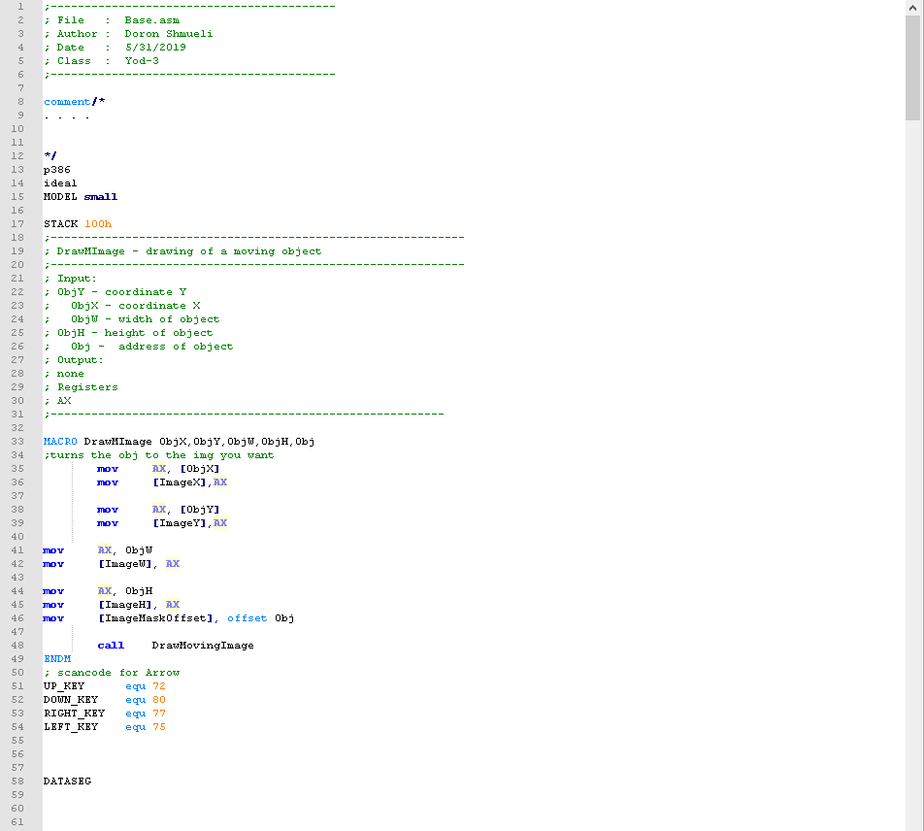
THE CODE

Slide 15
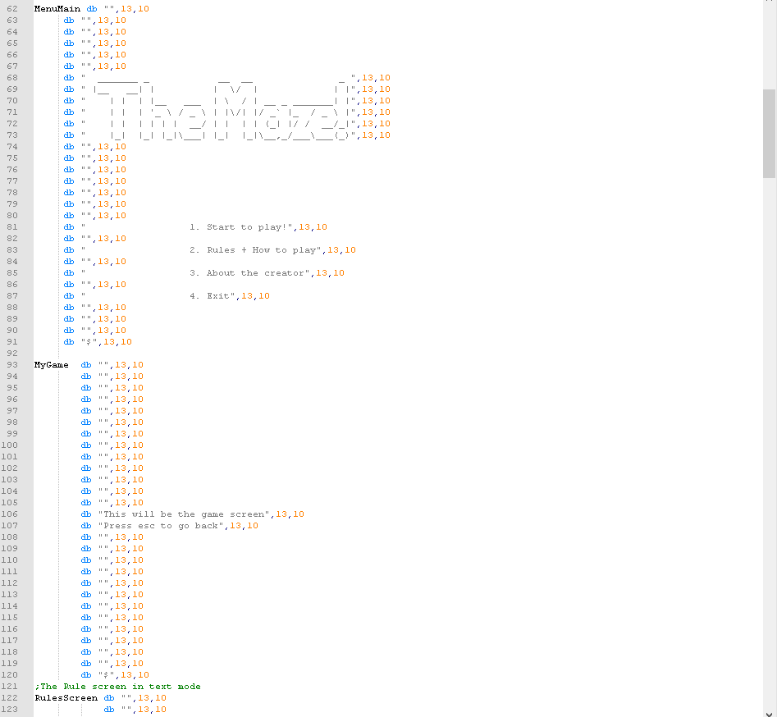

Slide 16
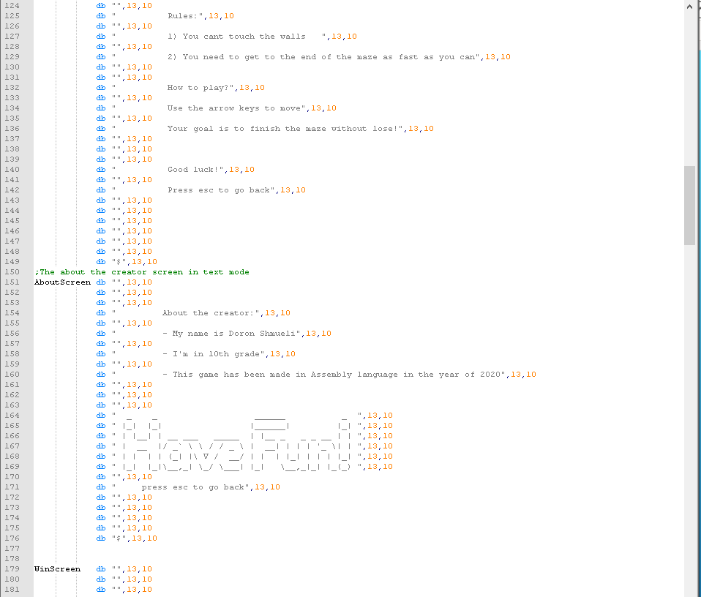

Slide 17
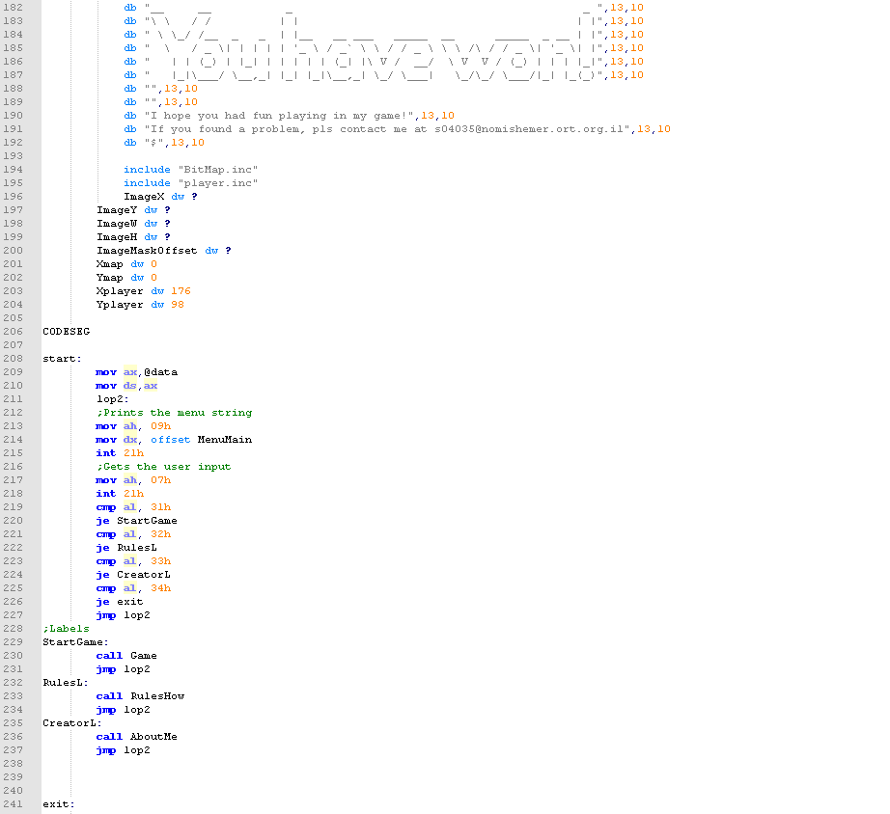

Slide 18
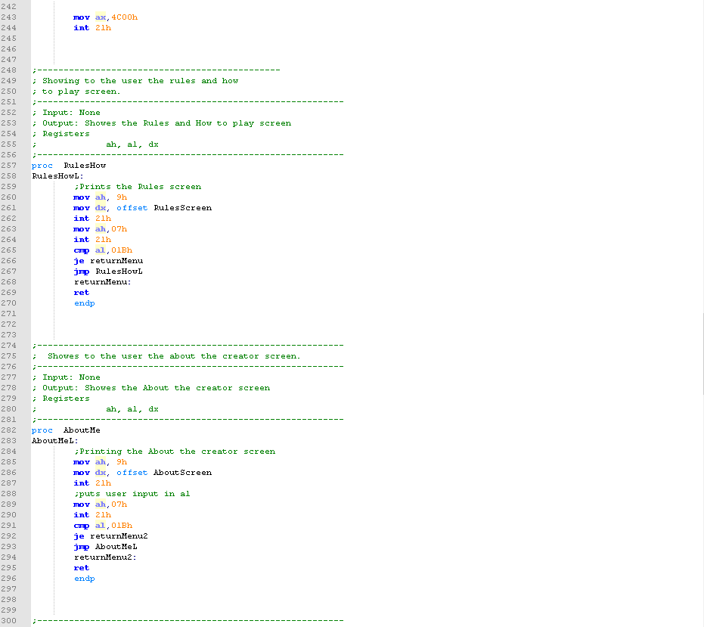

Slide 19
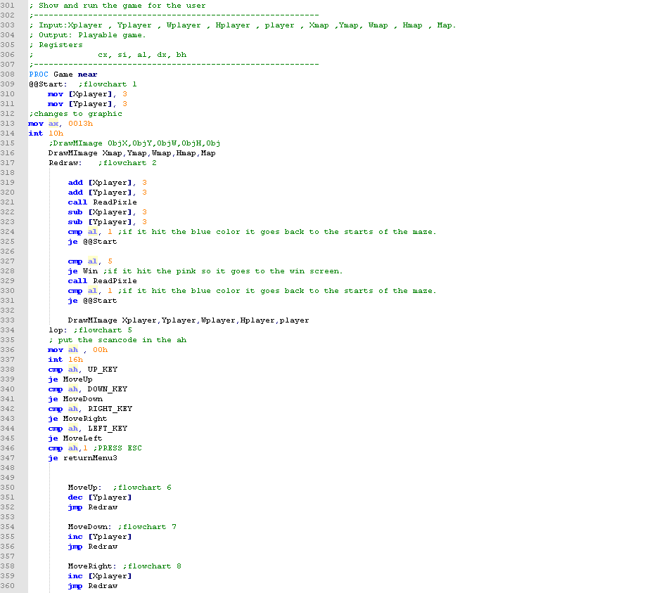

Slide 20
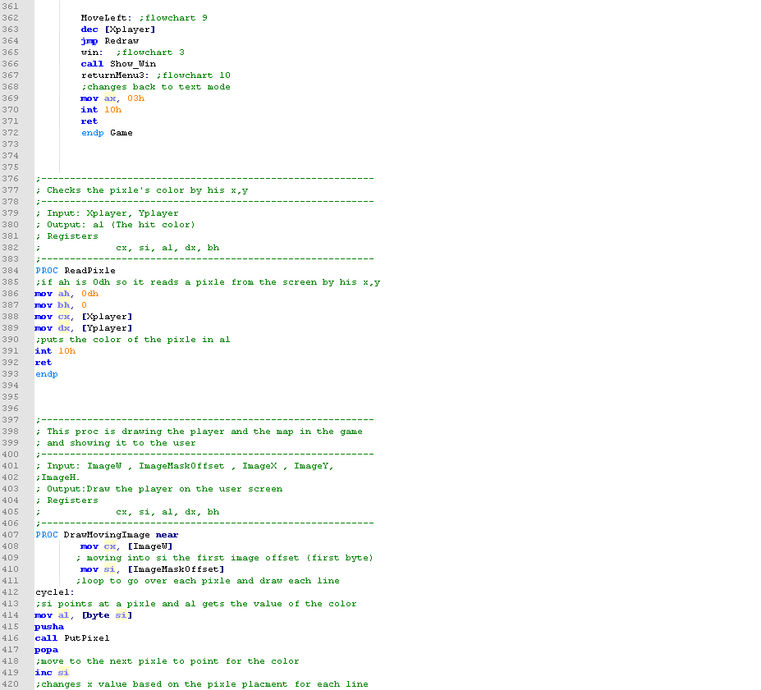

Slide 21
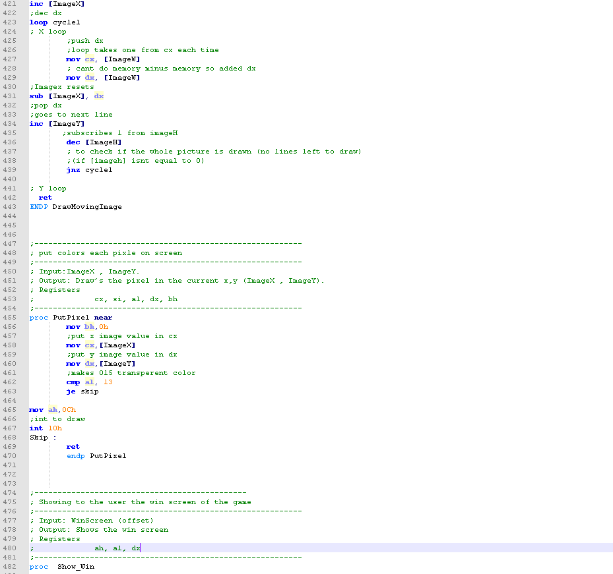

Slide 22
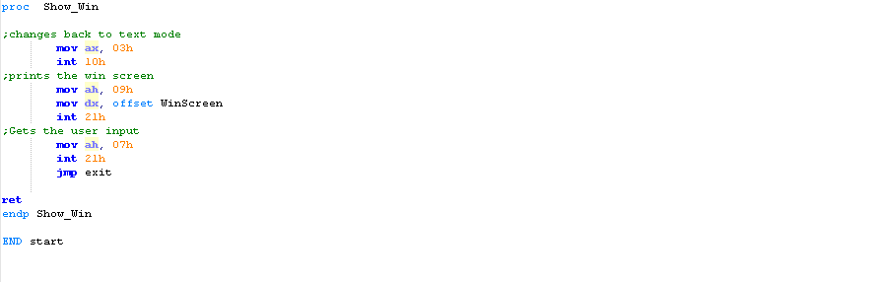

Slide 23
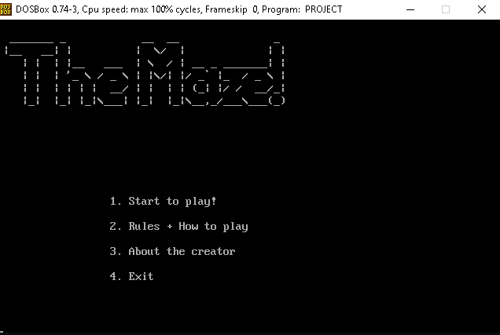
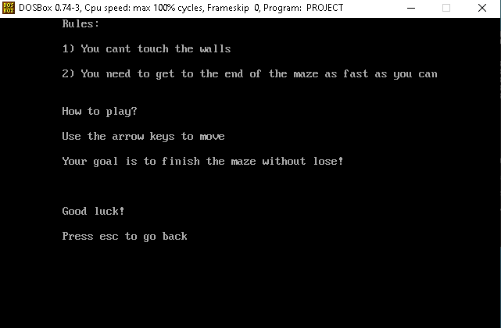
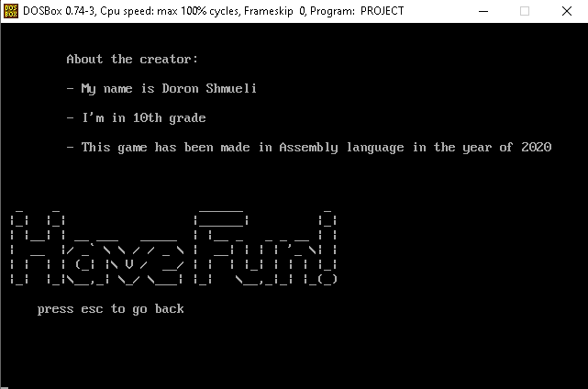
Example’s of running:

Slide 24
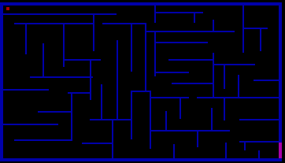
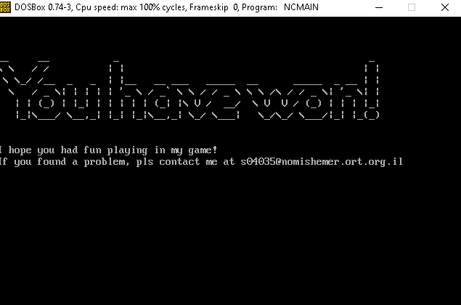

Slide 25
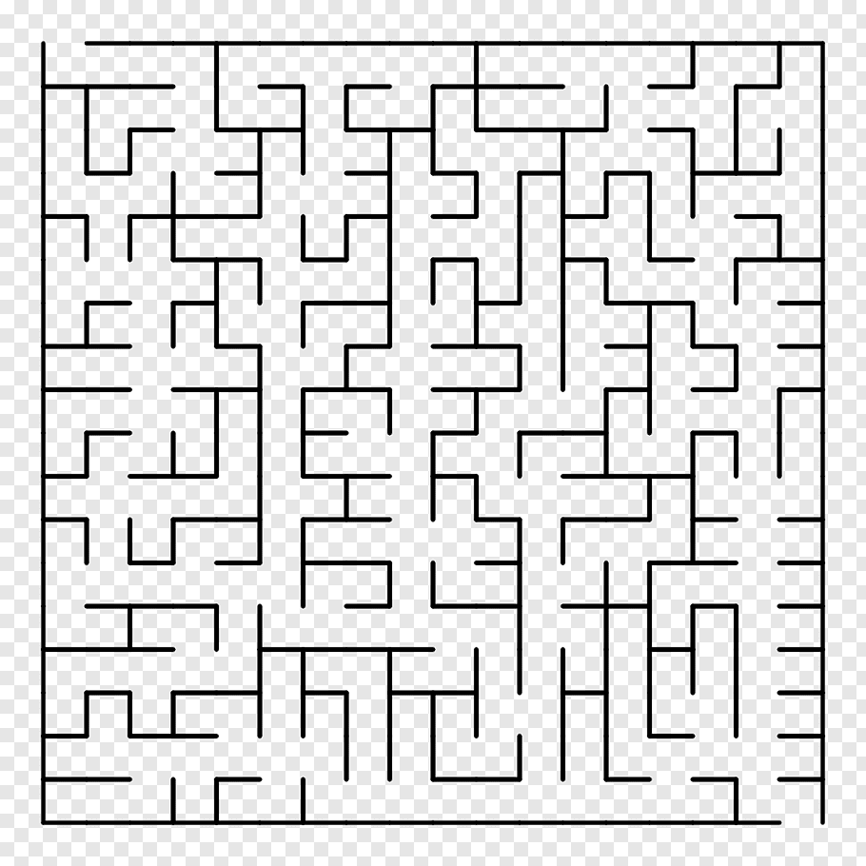
Personnel summery
This project taught me far beyond programming language, it taught me personal responsibility, it taught me to manage times properly
, it taught me to think correctly, it taught me the meaning of helping a friend who needs it during a crisis.
I am gone through this experience, it has made me significantly more mature.

Slide 26


Thanks
I would like to say would to the following people:
To my teacher Antoly who teach me the material.
To my parents who supported me and showed me that everything is possible if you really want it.
To my friends who helped me to write my game code and the procedures in it.
To DOSBox for the BEST RUNNING SPACE EVER.
To NotePad++ for letting me use their application for my assembler project.

